Slide 1
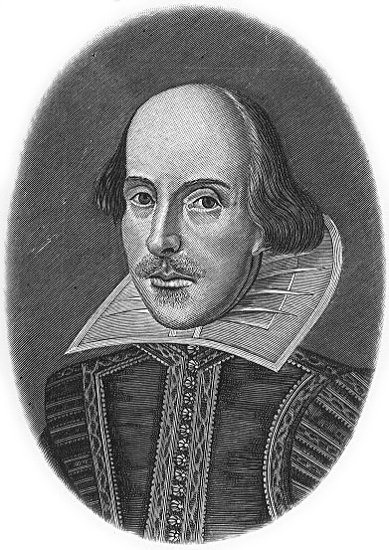
Lec 10: A Sampling of Eclipses in Literature
© Gerard Williger 2023, U Louisville
Ancient texts, including Bible
Shakespeare
Poetry: bad omens; unique light
Late 19th cent.: science fiction, lost worlds, time travel
20th–21st cent.: science fiction, children’s books, fantasy, horror
Shakespeare, undated, source LINK

Slide 2
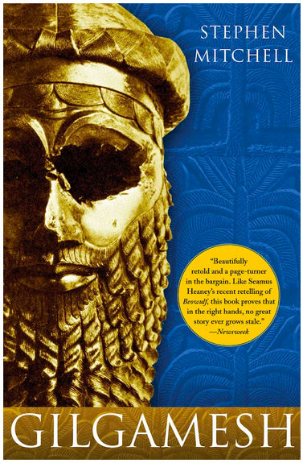
c. 2750-2500 BC, Gilgamesh
© Gerard Williger 2023, U Louisville
Babylonian, adventures of historical King of Uruk
Not very scientifically accurate
"Early in the morning at dawn a black cloud arose from the horizon . . . [the gods] turned everything to blackness."
LINK

Slide 3
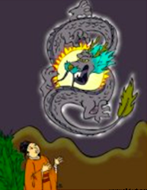
c. 2134 BC, China
© Gerard Williger 2023, U Louisville
Hsi and Ho -- believed to have been two astrologers who served the Emperor Chung K'ang around 2134 B.C. On October 22, a total solar eclipse occurred and it was recorded in the ancient Chinese document Shu Ching, that 'the Sun and Moon did not meet harmoniously’.
By some accounts, the two astrologers were negligent in their duties and did not foretell the event for the Emperor. They were summarily beheaded for their negligence of duty.
LINK
Image source LINK

Slide 4
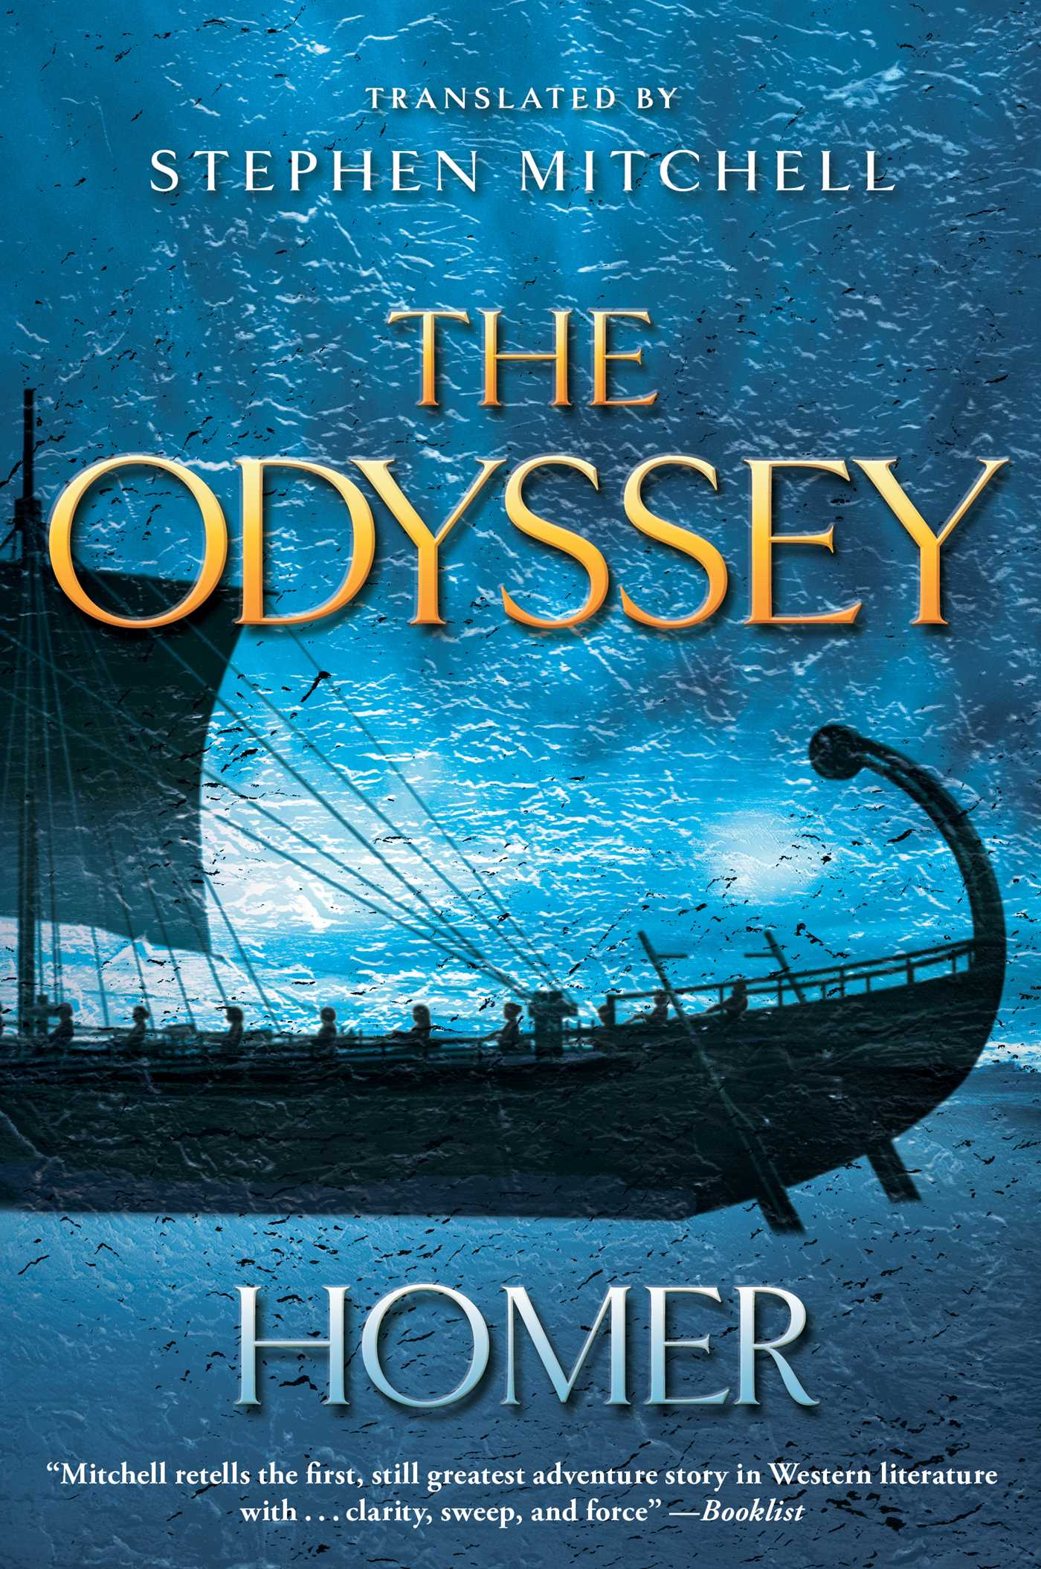
c. 800 BC, Homer, Odyssey
© Gerard Williger 2023, U Louisville
Odyssey, 'describes the 10-year voyage of the Greek general Odysseus to his home on the island of Ithaca after the fall of Troy in approximately 1200 B.C.
‘[a seer] Theoclymenus delivers his prophecy as the suitors are sitting down for their noontime meal. He foresees them entering Hades and ends his speech with the statement, "The Sun has been obliterated from the sky, and an unlucky darkness invades the world." ‘
Homer got other astronomical details right
LINK

Slide 5
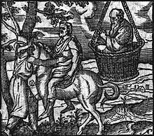
419 BC, Aristophanes, The Clouds
© Gerard Williger 2023, U Louisville
Greek comedy play, “a lampooning of intellectual fashions in classical Athens” LINK
Leader of the first semi-chorus:
``When you chose that enemy of heaven, the Paphlagonian tanner, for a general, we knitted our brow, we caused our wrath to break out; the lightning shot forth, the thunder pealed, the moon deserted her course and the sun at once veiled his beam threatening, no longer to give you light, if Cleon became general.”
Scene from The Clouds: Strepsiades and Pheidippiedes, with Socrates in a basket, 1564, Joannes Sambucus - LINK

Slide 6
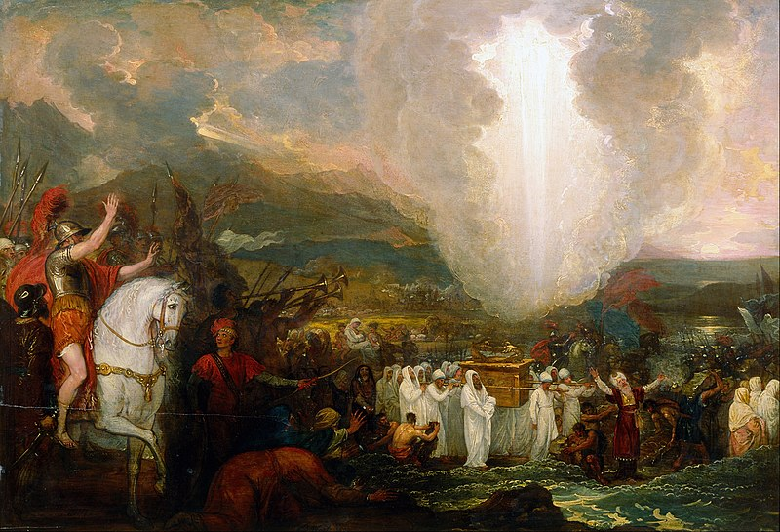
Oct. 27, 1207 BC, Bible – Joshua 10:12
© Gerard Williger 2023, U Louisville
When the Hebrew leader Joshua brings the Israelites into battle in Canaan:
"And he said in the sight of Israel, " sun, stand still at Gibeon, And O moon in the valley of Aijalon." So the sun stood still, and the moon stopped, Until the nation avenged themselves of their enemies.”
Humphreys & Waddington c. 2017: original Hebrew: "stopped" does not necessarily mean motion. It can mean "stopped shining". There was an annular eclipse at about the right time.
LINK ; 1.7’ video FYI
Joshua leads Israelites into Battle, 1800, Benjamin West - LINK

Slide 7
More from Bible
© Gerard Williger 2023, U Louisville
Joel 2:10 -- "The sun will be turned to darkness and the moon to blood before the coming of the great and dreadful day of the LORD.”
Amos 8:9 -- '"In that day," declares the Sovereign LORD, "I will make the sun go down at noon and darken the earth in broad daylight.”’
Matthew 24:29 -- "Immediately after the distress of those days -- the sun will be darkened, and the moon will not give its light; the stars will fall from the sky, and the heavenly bodies will be shaken."

Slide 8
Still more from Bible
© Gerard Williger 2023, U Louisville
Mark 15:33 -- "At noon, darkness came over the whole land until three in the afternoon."
Matthew 27:45 -- "From noon until three in the afternoon darkness came over all the land."
Acts 2:20 -- "The sun will be turned to darkness and the moon to blood before the coming of the great and glorious day of the Lord.”
Revelation 6:12 -- "I watched as he opened the sixth seal. There was a great earthquake. The sun turned black like sackcloth made of goat hair, the whole moon turned blood red,"

Slide 9
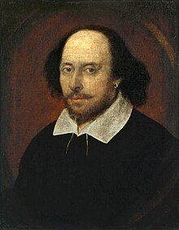
Eclipses in Shakespeare’s England
© Gerard Williger 2023, U Louisville
1590 – partial solar eclipse
Feb 21, 1598 – partial lunar eclipse
Mar 7, 1598 – total solar in SW, NW England, nearly total in Stratford
Jul 10, 1600 – total solar in Spain, partial in England
July 24, 1600 – partial lunar eclipse
1601 – partial solar
Apr 3, 1605 – partial lunar, perigee (super-Moon!), 99%, at sunset
Oct 12, 1605 – total solar in SW France, partial in England
Shakespeare, National Portrait Gallery

Slide 10
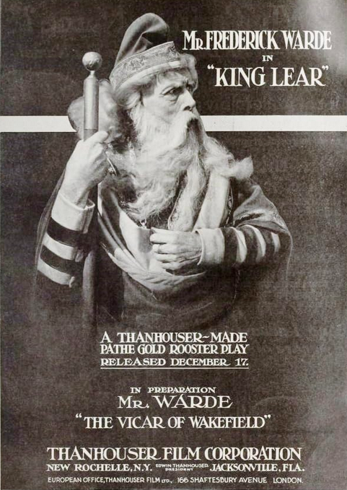
1603-06 King Lear; c 1606 Richard II
© Gerard Williger 2023, U Louisville
Act I, Scene 2: 'Gloucester attributes the chaos in Lear's court ... to " "these late eclipses of the sun and moon" (1.2.109). Edmund then mockingly takes up the theme of "what should follow these eclipses”’ (1.2.148) -- LINK
Richard II, Act 2, scene 4, "The pale-faced moon looks bloody on the Earth, And lean-looked prophets whisper fearful change;” ... "These signs forerun the death or fall of kings."
Frederick Warde as King Lear, 1916 - IMDB

Slide 11
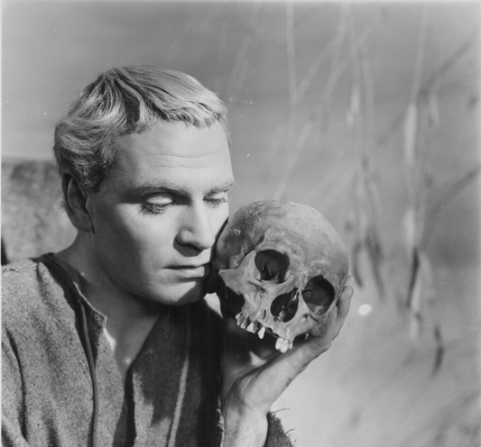
Hamlet ; Othello
© Gerard Williger 2023, U Louisville
Hamlet, Scene I: 'speculating about the Ghost, Horatio describes the portents that presaged the fall of Julius Caesar, one of which was a lunar eclipse: "the moist star / Upon whose influence Neptune's empire stands / Was sick almost to doomsday with eclipse" (106.11-13).’ – Robert V. O’Brien LINK
‘Othello laments murdering his wife by saying,
"Methinks it should be now a huge eclipse / Of sun and moon, and that the affrighted globe / Should yawn at alteration" (5.2.108-110).’
Laurence Olivier in Hamlet, 1948, IMDB

Slide 12
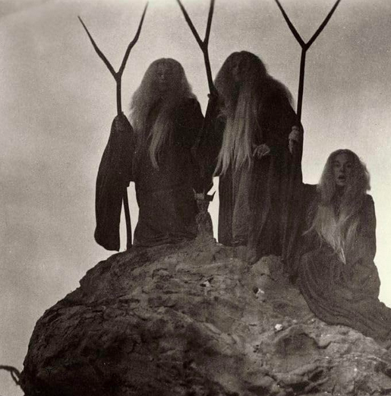
Macbeth ; Antony & Cleopatra
© Gerard Williger 2023, U Louisville
'The witches' brew ingredients in Macbeth include "slips of yew / Silvered in the moon's eclipse" (4.1.27-28).’ (O’Brien)
Antony & Cleopatra - 'After Cleopatra deserts Antony at the Battle of Actium and surrenders to Caesar, Antony says, "Alack, our terrene moon / Is now eclipsed, and it portends alone / The fall of Antony!" (3.13.156-58)
The "terrene moon" refers to Cleopatra, who was considered an avatar of the moon goddess Isis; the eclipse is her defeat, which portends Antony's.’ (O’Brien)
Witches, still from Macbeth (1948) - IMDB

Slide 13
W. Shakespeare Sonnets
© Gerard Williger 2023, U Louisville
Sonnet 35: ‘forgives his beloved by saying that everything has a bad side,’: "Clouds and eclipses stain both moon and sun” (O’Brien)
Sonnet 60: “Nativity, once in the main of light, Crawls to maturity, wherewith being crown'd, Crooked eclipses 'gainst his glory fight, And Time that gave doth now his gift confound.”
Sonnet 107: like his love, some things last: "The mortal moon hath her eclipse endured." (O’Brien)
9’ video, see 1:55-6:26 for excerpts

Slide 14
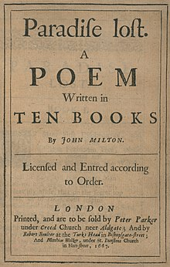
1667 J. Milton, Paradise Lost
© Gerard Williger 2023, U Louisville
In Book One of Paradise Lost, Milton draws on the traditional interpretation of the solar eclipse as a political portent in a simile describing Satan: (Lara Dodds, LINK)
"As when the Sun new ris'n Looks through the Horizontal misty Air Shorn of his Beams, or from behind the Moon In dim Eclips disastrous twilight sheds On half the Nations, and with fear of change Perplexes Monarchs." 1.591-99

Slide 15
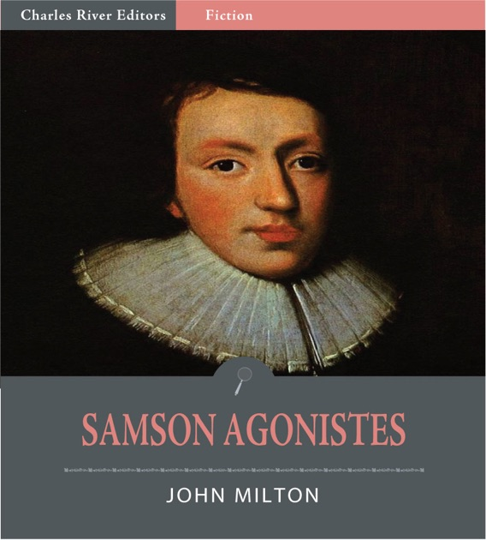
1671, J. Milton, Samson Agonistes 80-90
© Gerard Williger 2023, U Louisville
'the total solar eclipse is a metaphor for Samson's blindness and his feelings of physical and spiritual isolation at the beginning of the play:’ (Dodds)
"O dark, dark, dark, amid the blaze of noon,
Irrecoverably dark, total Eclipse
Without all hope of day!
O first created Beam, and thou great Word,
Let there be light, and light was over all;
Why am I thus bereav'd thy prime decree?
The Sun to me is dark
And silent as the Moon,
When she deserts the night
Hid in her vacant interlunar cave."
Apple Books, 2014

Slide 16
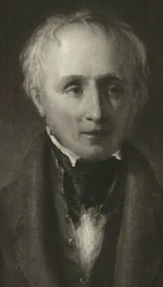
1820 W. Wordsworth, The Eclipse of the Sun
© Gerard Williger 2023, U Louisville
No vapour stretched its wings; no cloud
Cast far or near a murky shroud;
The sky an azure field displayed;
'Twas sunlight sheathed and gently charmed,
Of all its sparkling rays disarmed,
And as in slumber laid: --
Or something night and day between,
Like moonshine -- but the hue was green;
Still moonshine, without shadow, spread
On jutting rock, and curvèd shore,
Where gazed the Peasant from his door,
And on the mountain's head.
. . . . .
Lo! while I speak, the labouring Sun
His glad deliverance has begun:
The cypress waves its sombre plume
More cheerily; and Town and Tower, The vineyard and the Olive bower,
Their lustre re-assume!
William Wordsworth, National Portrait Gallery, London (portion)
A thoughtful description of the light during an eclipse

Slide 17
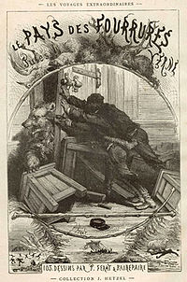
1873 Jules Verne, The Fur Country
© Gerard Williger 2023, U Louisville
Science Fiction: “Scientists witness a solar eclipse north of the Arctic Circle in the summer of 1860.
At some point, an earthquake occurs, and from then on, laws of physics seem altered (a total eclipse happens to be only partial; tides are not perceived anymore).
They eventually realise that they are on an iceberg separated from the sea ice that is drifting south. …” LINK

Slide 18
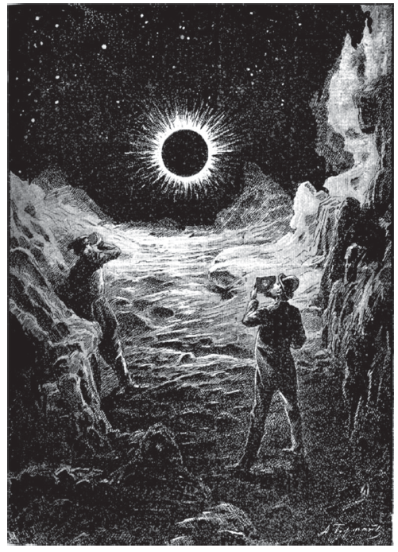
1887, Konstantin Tsiolkovsky, On the Moon
© Gerard Williger 2023, U Louisville
More science fiction:
Two men go to the Moon to see a ”terrestrial eclipse”
-- not as beautiful, because Earth blocks much of Sun’s corona
-- illustration definitely misleading
Corona too bright
Lunar landscape too bright
-- Still a good portent of Apollo landings!
Illustration by A. Gofman
Notes:
Edits to here 2024.02.17 1537 EST

Slide 19
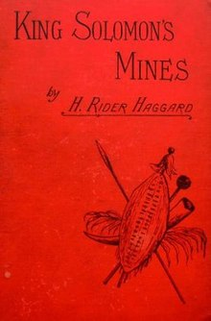
1885, HR Haggard, King Solomon’s Mines
© Gerard Williger 2023, U Louisville
One of first English adventure novels set in Africa
-- Genesis of “lost world” literary genre
-- written in age of discovery of ancient Egypt, Assyria etc.
-- much fanfare, immediate best-seller
-- “…a search of an unexplored region of Africa by a group of adventurers … for the missing brother of one of the party. ” LINK (Wikipedia)
-- used an altered version of the real story of the rescue of Columbus … [the explorers] use their foreknowledge of a solar eclipse to claim that they will black out the Sun as proof of their powers
Had scientific errors in 1st edition, fixed subsequently (Frank Close 2019, Eclipses - LINK)

Slide 20
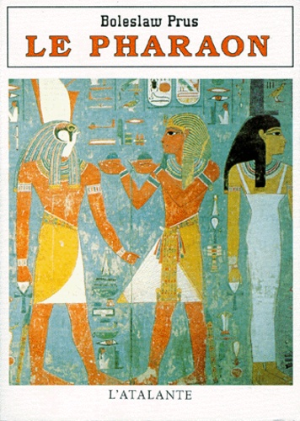
1888/94-95, Bolesaw Prus, Pharoah
© Gerard Williger 2023, U Louisville
"After Bolesaw witnessed the [Aug. 19,] 1887 solar eclipse himself, he was inspired to write one into the climactic scene of his novel. In the book, Pharaoh Ramses' chief adversary, Herhor, exploits a solar eclipse and pretends that he has the power to control the sun” [published in English, 1894-95]
Charlotte Ahlin, 2017, LINK
Related to his work, The Legends of Ancient Egypt, published Jan. 1, 1888, in Polish

Slide 21
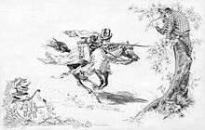
1889, M Twain, A Connecticut Yankee in King Arthur’s Court
© Gerard Williger 2023, U Louisville
'Hank, saves himself from execution by remembering the date of [a] historical solar eclipse … if he is put to death, he will use magic to forever blot out the sun. … at the very last moment, the sun is eclipsed and everyone is plunged into darkness. The courtiers are terrified and release Hank, who pretends to "return" the sun to them’ LINK
Another case of using an eclipse prediction to show power
Frontspiece, 1889 (restored), Daniel Carter Beard - LINK
An American dreams that he goes back to Camelot, and has many adventures.

Slide 22
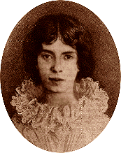
1891, E Dickinson, It sounded as if the Streets were running
© Gerard Williger 2023, U Louisville
It sounded as if the Streets were running
And then -- the Streets stood still --
Eclipse -- was all we could see at the Window
And Awe -- was all we could feel.
By and by -- the boldest stole out of his Covert
To see if Time was there --
Nature was in an Opal Apron,
Mixing fresher Air.
Emily Dickinson (1830-1886), as an adult, altered version, public domain, Wikipedia
Is the “Opal Apron” a reference to the pearly corona?

Slide 23
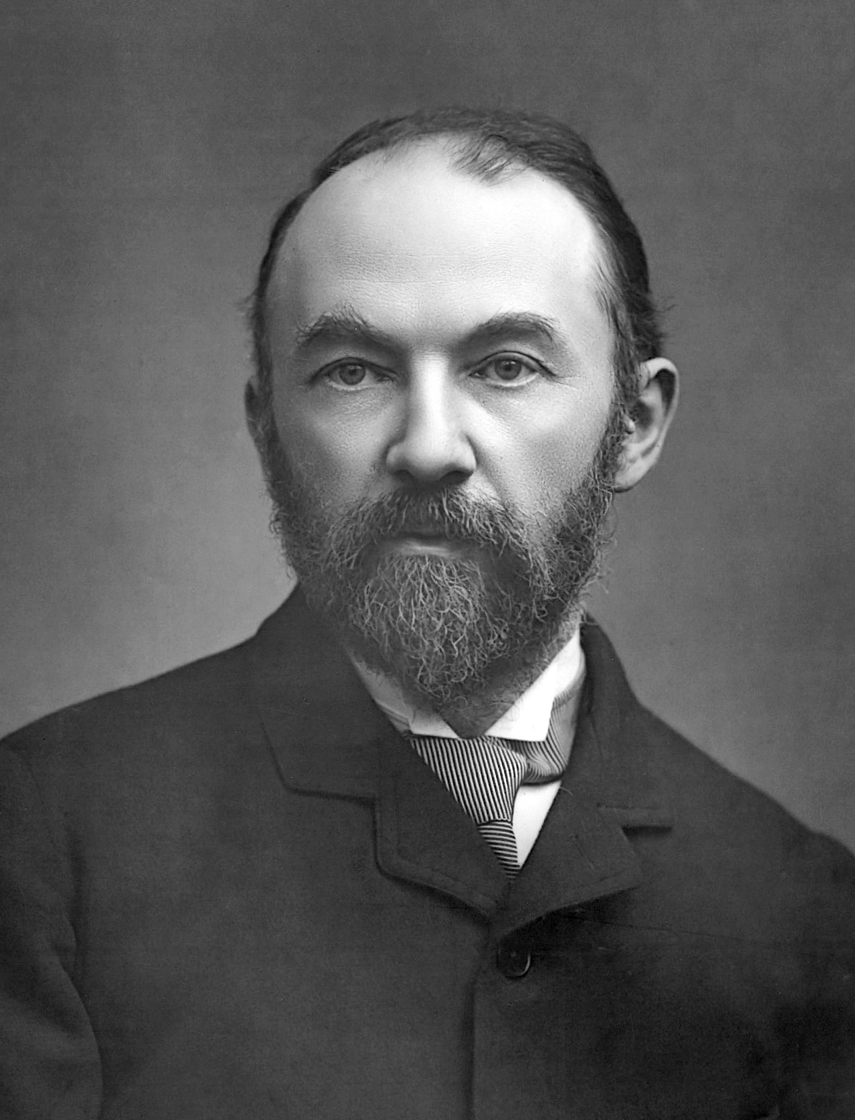
1902, Thomas Hardy, At a lunar eclipse
© Gerard Williger 2023, U Louisville
Thy shadow, Earth, from Pole to Central Sea,
Now steals along upon the Moon's meek shine
In even monochrome and curving line
Of imperturbable serenity.
How shall I link such suncast symmetry
With the torn troubled form I know as thine,
That profile, placid as a brow divine,
With continents of moil and misery?
And can immense Mortality but throw
So small a shade, and Heaven's high human scheme
Be hemmed within the coasts yon arc implies?
Is such the stellar gauge of earthly show,
Nation at war with nation, brains that teem,
Heroes, and women fairer than the skies?
From: Hardy, Poems of the Past and Present, first published 1902, LINK
Thomas Hardy, 1889, public domain, Wikipedia
FYI Audio file, 0.7’, link
Notes:
This may express some condemnation of conflict between nations, as it is during the decade before WWI.

Slide 24
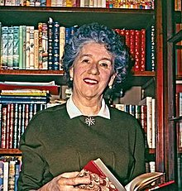

c. 1940, Enid Blyton, Secret Mountain
© Gerard Williger 2023, U Louisville
"A group of children and their guardian, captives of a sun-worshipping African tribe, escape by threatening to kill the sun, having prior knowledge of an imminent solar eclipse.”
LINK
Enid Blyton (1897-1968), Encyclopedia Britannica and Wikipedia
Image LINK

Slide 25
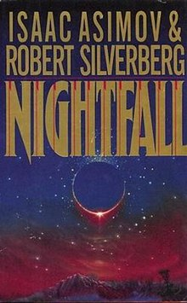
1941, Isaac Asimov, Nightfall
© Gerard Williger 2023, U Louisville
“But what happens when there's an eclipse on a planet that has never known darkness?
[a planet] is illuminated at all times by at least one of its six suns. No one has ever known night. A rare, total eclipse gives the inhabitants … their first ever view of the night sky...and the shocking revelation of stars, and the possibility of other planets out there in the universe, drives the entire population mad.” LINK
1990 edition, with Robert Silverberg, Wikipedia

Slide 26
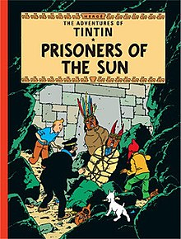
1949, Hergé, Tin Tin: Prisoners of the Sun
© Gerard Williger 2023, U Louisville
'Tintin and Captain Haddock are captured by the Prince of the Sun in Peru, and sentenced to death for being nosy jerks.
But the Prince lets Tintin choose the hour of their death, and of course Tintin picks the exact moment of a handy solar eclipse. The Prince and his people are so freaked out by Tintin's ability to command the sun that they agree to free him if he brings daylight back.’
LINK
Frontspiece, English edition, Wikipedia, Hergé Foundation

Slide 27
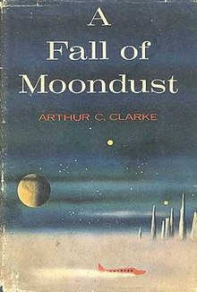
1961, A.C. Clarke, A Fall of Moondust
© Gerard Williger 2023, U Louisville
During an early tourist trip to the Moon, a lander has an accident,
ends up in a collapsed lava tube and gets buried in Moon dust.
A difficult rescue mission is launched.
"...a lunar eclipse plays a pivotal role in the story, providing a unique backdrop for the unfolding drama.”
LINK
First US Edition, Harcourt Brace, Wikipedia

Slide 28

1982, A. Dillard, Total Eclipse, Atlantic Magazine
© Gerard Williger 2023, U Louisville
“The sun was going, and the world was wrong. The grasses were wrong; they were platinum. Their every detail of stem, head, and blade shone lightless and artificially distinct as an art photographer's platinum print. This color has never been seen on Earth. The hues were metallic; their finish was matte. The hillside was a 19th-century tinted photograph from which the tints had faded.
I was watching a faded color print of a movie filmed in the Middle Ages; I was standing in it, by some mistake. I was standing in a movie of hillside grasses filmed in the Middle Ages. I missed my own century, the people I knew, and the real light of day.”
Describes Feb. 26, 1979, State of Washington
Lara Dodds, LINK ; article LINK (2017)
From Dillard 2016, The Abundance (anthology), Harper Collins; Pulitzer Prize winner, 1975
Notes:
Reminiscent of description of special eclipse light by William Wordsworth

Slide 29
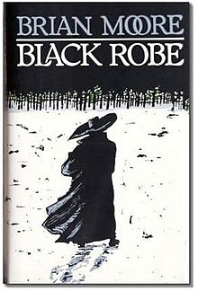
1985, Brian Moore, Black Robe
© Gerard Williger 2023, U Louisville
Jesuit missionaries in 17th century Quebec
use their astronomical knowledge of the exact time of an eclipse to prevent their slaughter by Hurons.
LINK
Later turned into a 1991 movie
From first UK edition, published by Jonathan Cape

Slide 30

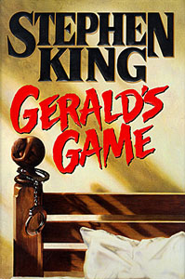
1992, S. King, Dolores Claiborne & Gerald’s Game
© Gerard Williger 2023, U Louisville
"King actually planned a longer series called In the Path of the Eclipse, but for now he has two novels linked by the same solar eclipse.
In Dolores Claiborne, Dolores uses the cover of the 1963 solar eclipse to murder her abusive husband.
The same solar eclipse appears in Gerald's Game, as Jessie relives a traumatic incident from her childhood that took place during the midday darkness.”
LINK
1st ed. Covers, Viking Press

Slide 31

c. 1996, A. Monterroso, El Eclipse (short story)
© Gerard Williger 2023, U Louisville
"a Spanish missionary is captured by Mayans and tries to use his knowledge of a solar eclipse to scare them into releasing him. They sacrifice him anyway, already having calculated the infinite dates of upcoming eclipses.”
LINK ; Spanish text LINK

Slide 32
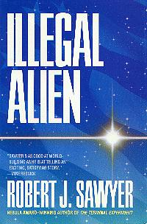
1997, R.J. Sawyer, Illegal Alien
© Gerard Williger 2023, U Louisville
Aliens come to our Solar System, suffer an accident and need repairs.
While fixing their ship on Earth, they are awed by the Aug. 11, 1999 eclipse.
An Earth scientist tells them that [Earth] may be the only place in our Milky Way Galaxy where by coincidence a moon blocks a star’s disk but not its corona.
LINK
Ace Books ; won 2002 Seiun Award in Japan for Best Foreign Novel
Novel focuses on an inter-species murder trial. Canadian Sawyer made “an outsider’s view of American justice” (LINK - Wikipedia)

Slide 33
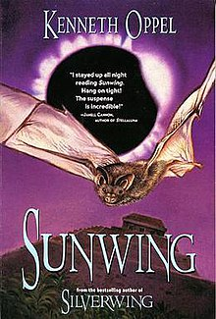
1999, Kenneth Oppel, Sunwing
© Gerard Williger 2023, U Louisville
Children’s fantasy, 2nd part of trilogy
Good bats fight bad birds
"Goth, reaching his home in an ancient Mayan pyramid, is anointed king and told of a prophecy by his priest, Voxzaco. According to the prophecy, if a hundred hearts are offered to their god, Cama Zotz, the coming solar eclipse will last forever, allowing Zotz to rule both the Upperworld and Underworld.”
The battle between Good and Evil ensues
LINK
1st edition cover, HarperCollins
Oppel is another Canadian author.

Slide 34
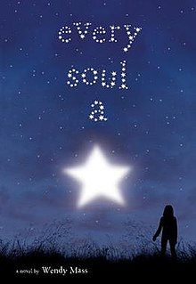
2008, Wendy Mass, Every Soul a Star
© Gerard Williger 2023, U Louisville
Story of 3 teenagers – clichés of adolescence
Brainiac, Pretty Girl, Social Misfit
come together and learn about life [and themselves] during a solar eclipse.
“At Moon Shadow, an isolated campground, thousands have gathered to catch a glimpse of a rare and extraordinary total eclipse of the sun. It's also were three lives are about to be changed forever…” (LINK – goodreads.com) ; LINK - Wikipedia
Published by Little, Brown Books for Young Readers
Mass has written 30 novels for young people

Slide 35

2009, G. del Toro & C. Hogan, The Strain
© Gerard Williger 2023, U Louisville
"... sci-fi series begins with a total eclipse that lets our vampiric friends finally venture out in the daytime ... and start spreading their vampiric virus to everyone in New York City.” LINK
Made into TV series on FX, 2014-17
“A Boeing 777 arrives at [JFK] Airport and is taxiing its way across the tarmac when it suddenly stops. All window shades are closed except one, the lights are out, and communication channels have gone silent. …” LINK-Wikipedia
Published by William Morrow
Del Toro is a Mexican director. Hogan is an American writer.

Slide 36
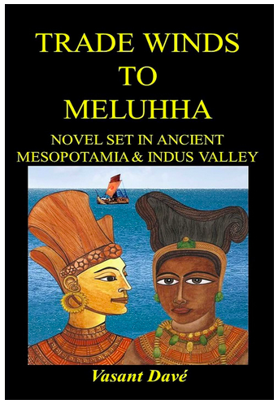
2012, Vasant Davé, Trade Winds to Meluhha
© Gerard Williger 2023, U Louisville
“A historical novel where the unique total lunar eclipse and total solar eclipse in Babylon on May 9, 2138 BC set off a young Mesopotamian’s adventures in the ancient Indus Valley civilization.” LINK
“Inspired by Thor Heyerdahl's expedition in a reed ship across the Persian Gulf and the Arabian Sea, [it] narrates one man's dogged pursuit to end an evil trade wrecking many a young Mesopotamian's life.” LINK-Goodreads
Published by Vasantrai P. Davé, and RR Roy, India
Davé is a retired electrical engineer with a passion for exploring Indus Valley civilizations. LINK

Slide 37
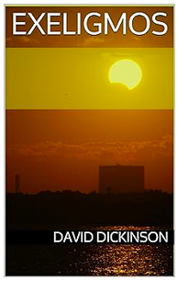
2014, David Dickinson, Exeligmos, short story
© Gerard Williger 2023, U Louisville
Exeligmos = set of 3 Saros cycles
Resets about to original longitude
‘The owner of Exeligmos Eclipse Tours is about to add a new level to the definition of infatuation, as he plunges ever further back into history searching for that perfect "triple saros..." But are the history books all that they seem? Exeligmos is a fascinating fictional look at eclipse chasing from a science fiction perspective.’ LINK
Also wrote Shadowfall (eclipse-themed)
Kindle book. Image from amazon.com
Dickson is a US Air Force veteran, Earth science teacher and science writer

Slide 38

2015, Elsa Hart, Jade Dragon Mountain
© Gerard Williger 2023, U Louisville
"Li Du was an imperial Chinese librarian. In 1780, three years of wandering have brought him to [the Tibetan border]. … The crowds have been drawn by the promise of an unmatched spectacle; an eclipse of the sun, commanded by the Emperor himself.
Amid the frenzy, Li Du befriends an elderly Jesuit astronomer. Hours later, the man is murdered in the home of the local magistrate
… Li Du must solve the murder before the sun disappears.” LINK
Published by Minotaur Books
Hart has written several mystery novels set in 18th century China.

Slide 39
SUMMARY
© Gerard Williger 2023, U Louisville
Eclipses in literature for > 5000 years
Some of greatest writers employed them
Early literature: tends to bad omens
Enlightenment:
Fear gone, more scientifically accurate
Industrial/Gilded age: reflected back on past fear
Started to emphasize beauty of eclipses, shadows
Lost worlds, time travel themes, predicting past eclipses
20th-21st century:
more science fiction, children’s literature, time travel themes, historical fiction, horror
Explosion of varieties of story lines

